Slide 1
Gift to Cycle 38 and staff
By Kateryna Turchyna

Slide 2
Guess Who …….

Slide 3
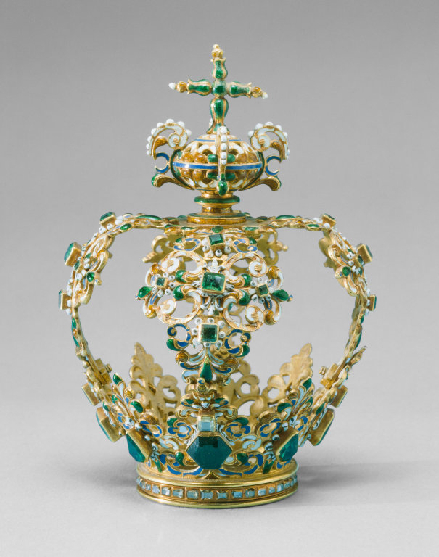
…is a wise queen of i.c.stars?

Slide 4
…Sandee

Slide 5
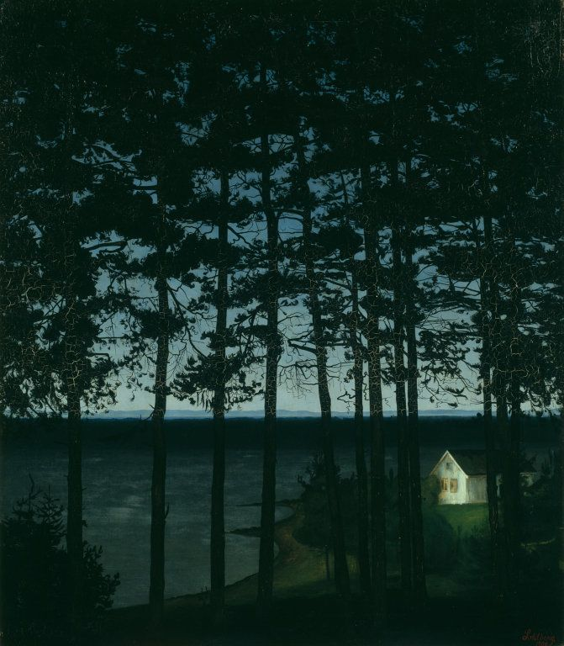
…tries to find only good in all interns and was our advocate from the beginning of the cycle?

Slide 6
…Rico

Slide 7

…always remembers about our deadlines and remind us about things we should accomplish?

Slide 8
…Arlene

Slide 9
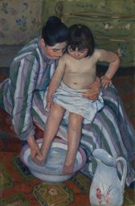
… sees helping and serving people as purpose of the life?

Slide 10
…Thom

Slide 11
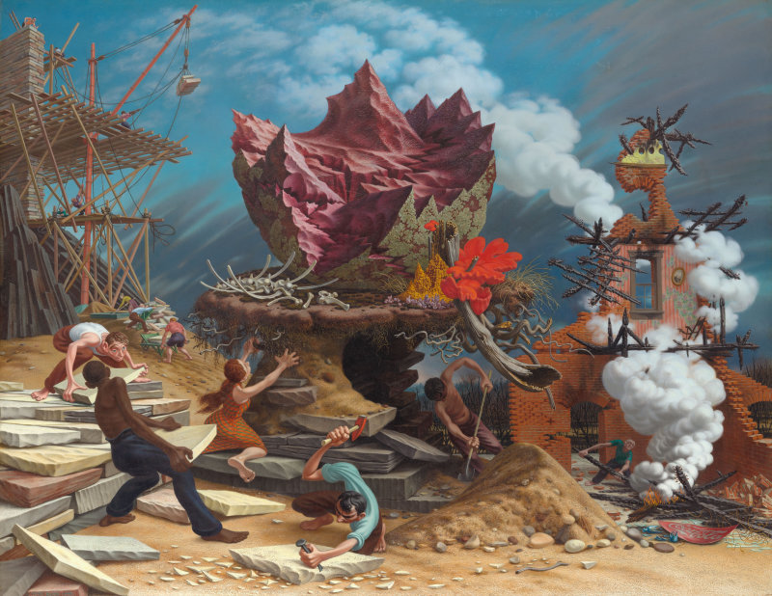
…helps us to build our future even tough it is challenging?

Slide 12
…Das

Slide 13
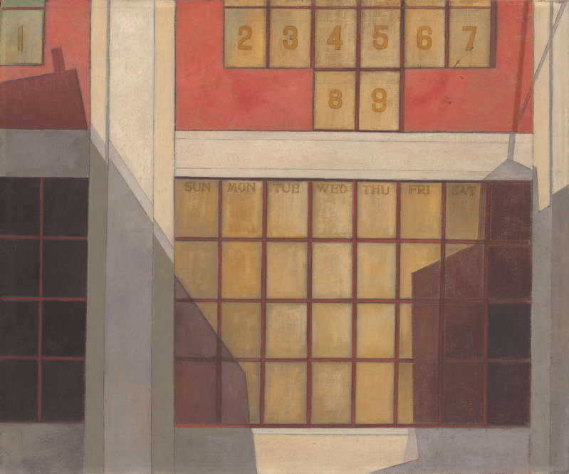
…is keen on data and numbers.

Slide 14
…Gillian

Slide 15
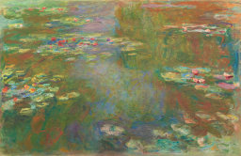
…speaks French, and earned a master’s from the Institute of Political Studies in Toulouse, France.

Slide 16
…Elizabeth

Slide 17
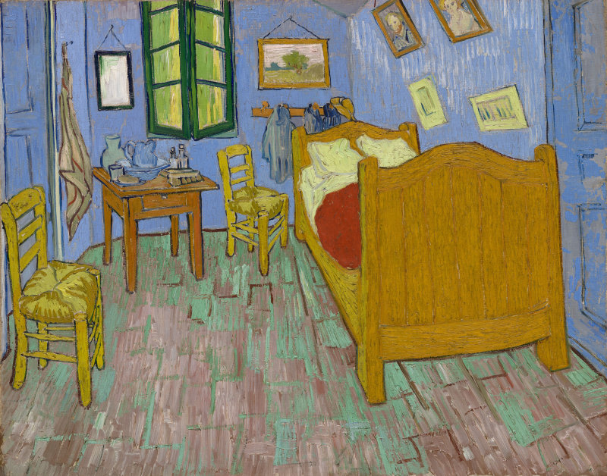
…makes us feel home and cozy from the beginning of the cycle.

Slide 18
…Tandelaya

Slide 19
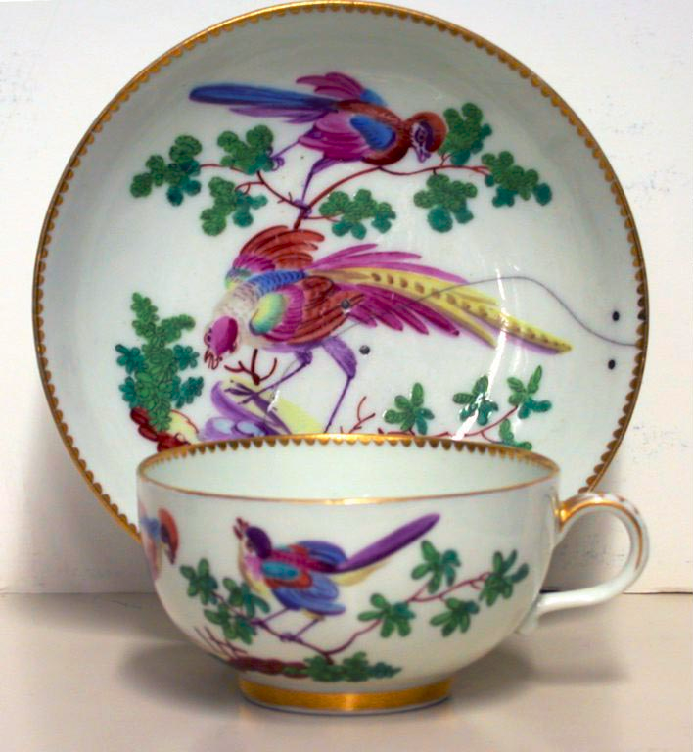
…helps us to organize High Tea

Slide 20
…Amanda

Slide 21
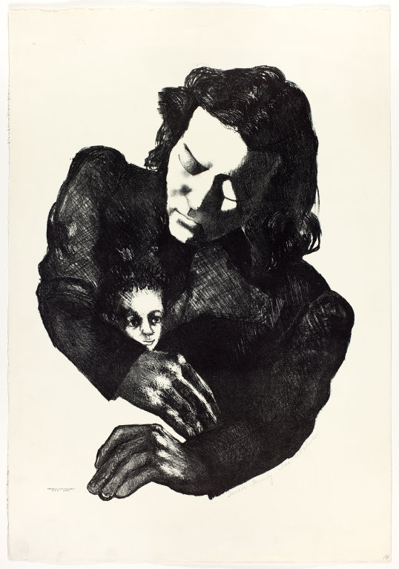
… has tough jokes but very kind heart.

Slide 22
…Saul

Slide 23
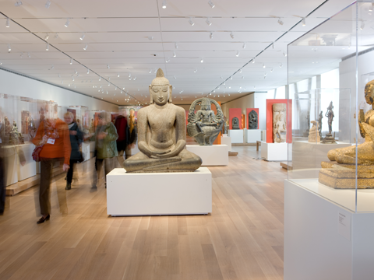
…firstly seemed very strict, calm and unemotional. I even called him “Sir” during the first night school.)

Slide 24
…Jonte

Slide 25
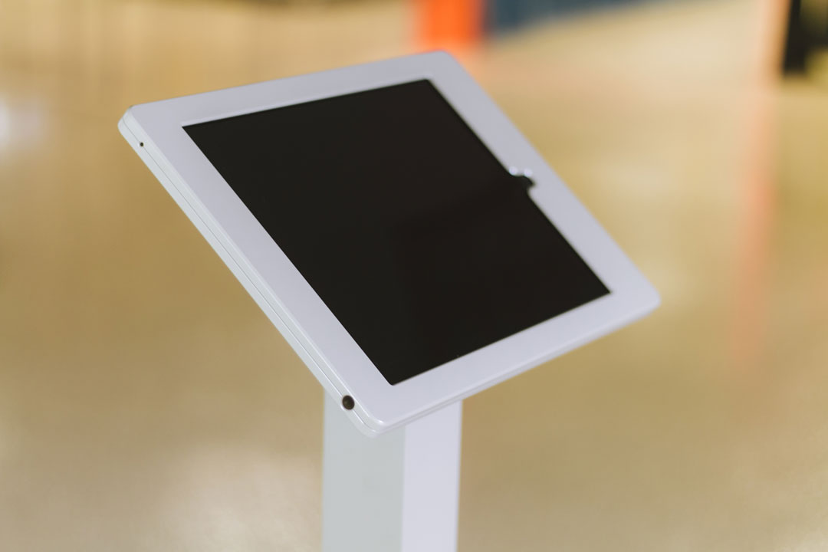
…is a resource coordinator, hardware guy.

Slide 26
…Finley

Slide 27
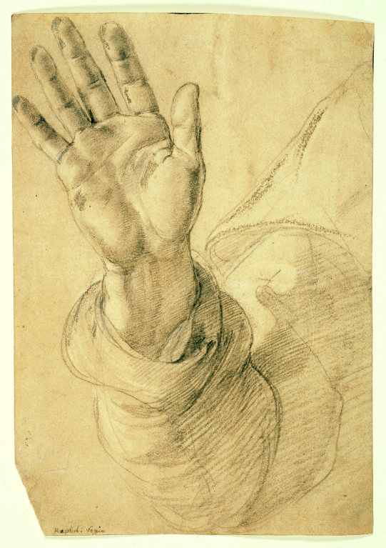
…are always ready to give you a hand and also draw good. (2 persons)

Slide 28
…Larman and Gavin

Slide 29
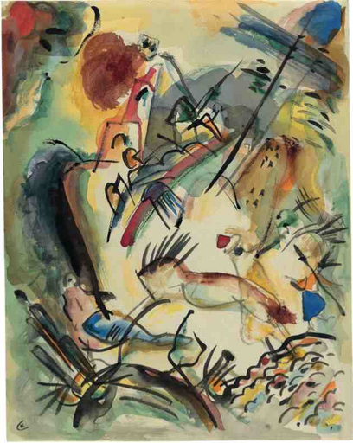
…helps us to put everything in our head in order.

Slide 30
…Kim

Slide 31
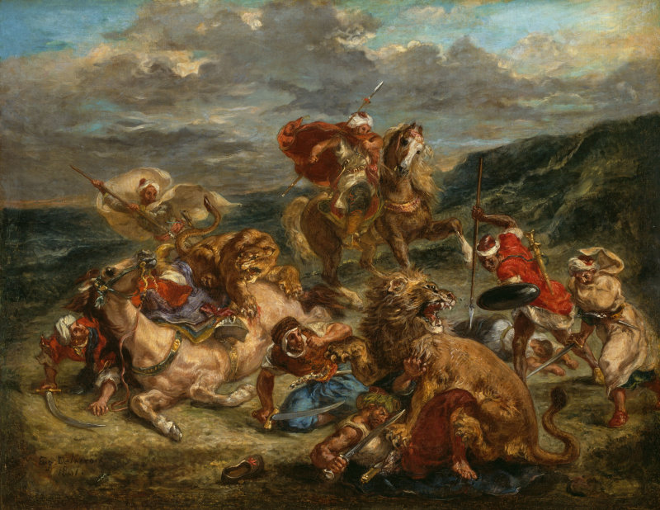
…fearless enough to ask a question during High Tea?

Slide 32
…Devonte

Slide 33
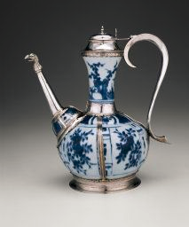
…is very sensible. Be polite and calm working together!

Slide 34
…Viseth

Slide 35

…fascinated by power of words.

Slide 36
…Dan

Slide 37
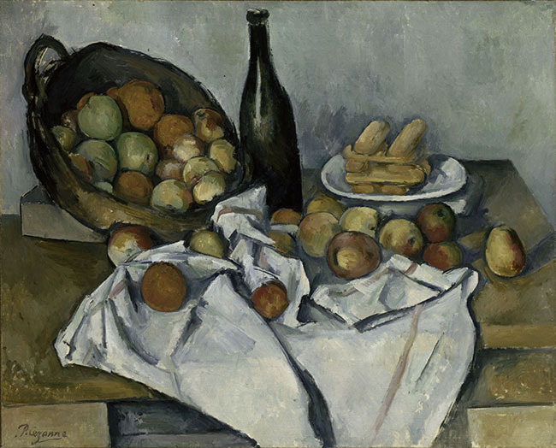
…is a big foodie?

Slide 38
…Endre

Slide 39
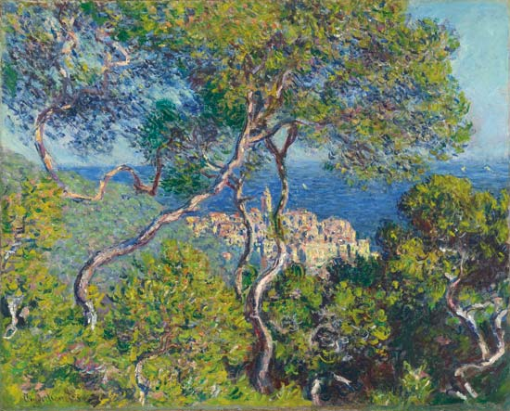
…is always in a sunny mood?

Slide 40
…Jeniece

Slide 41
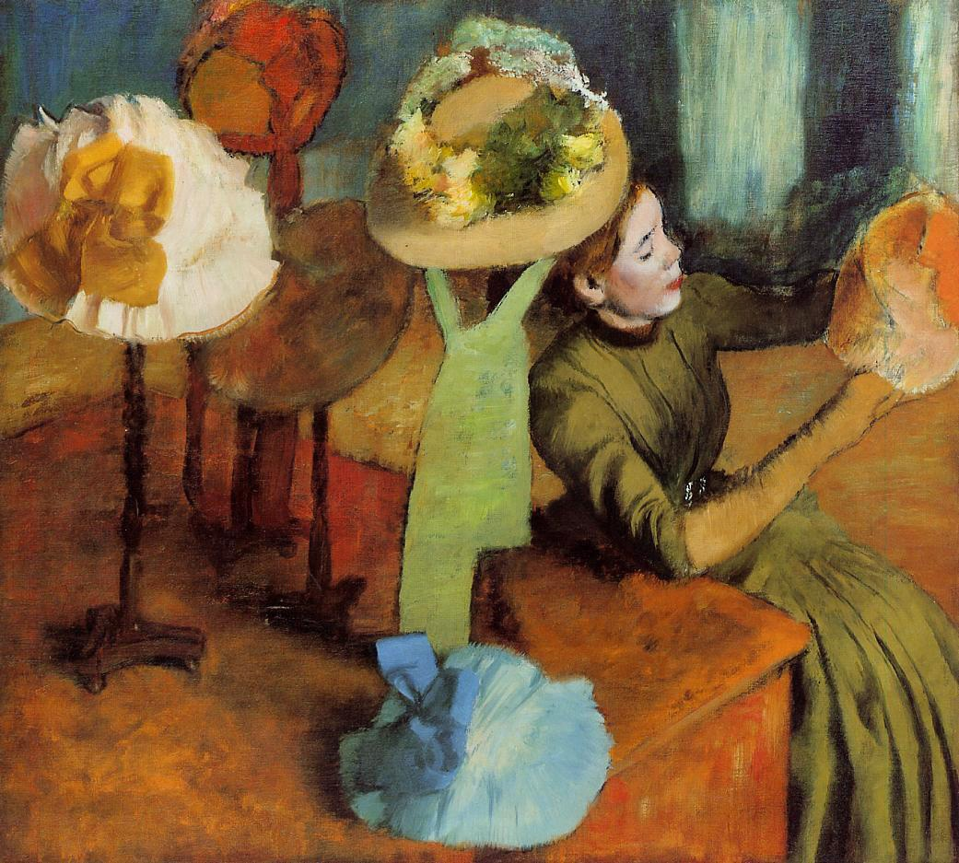
…a person who looooves fashion. Should I even ask?)

Slide 42
…Loreina

Slide 43
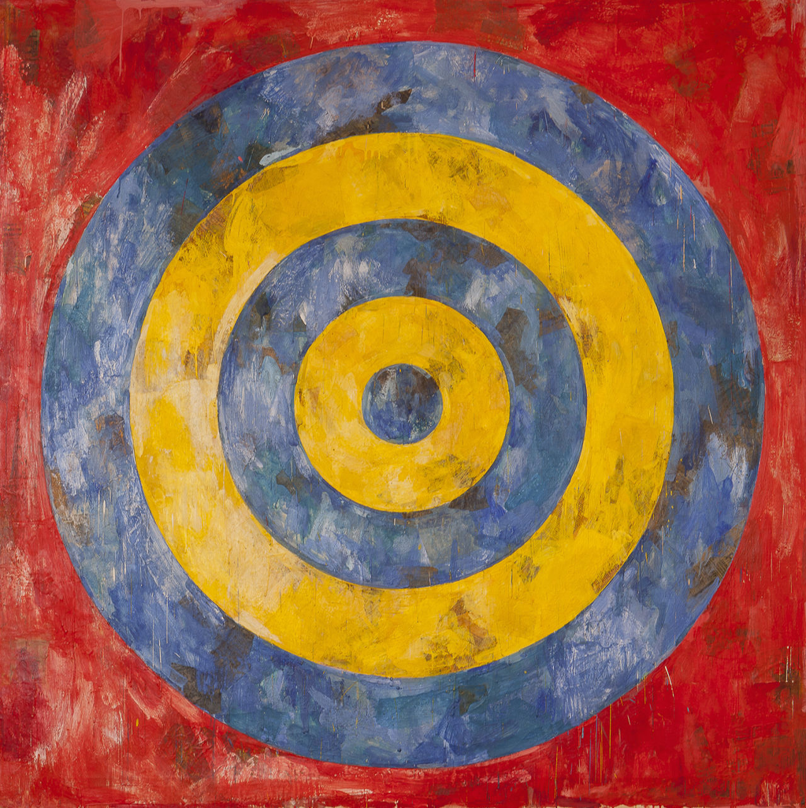
…is the most purposeful person of your Cycle?

Slide 44
…Min

Slide 45
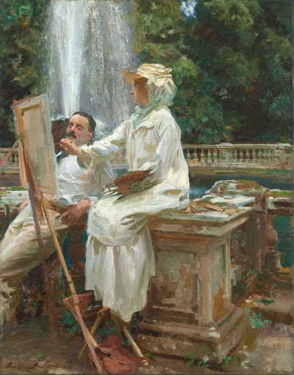
…is experienced artist?

Slide 46
…Tina

Slide 47
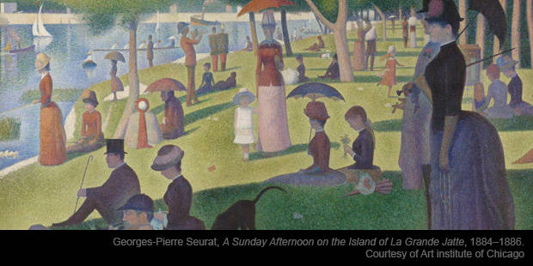
…people person of your Cycle?

Slide 48
…Vanessa

Slide 49
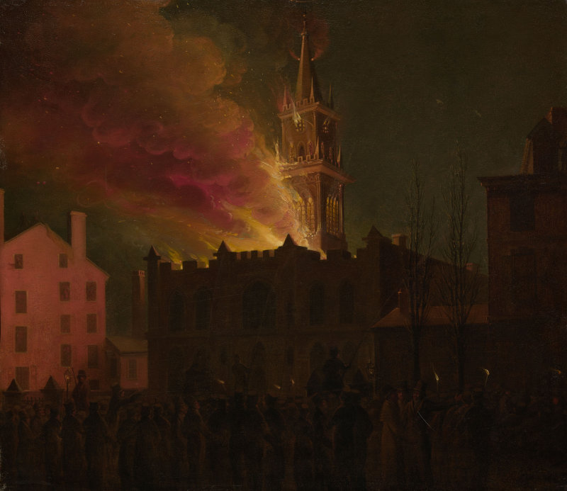
…fire-woman of our Cycle? (She is always on fire, has great sense of humor and a lot of energy.)

Slide 50
…Molly

Slide 51
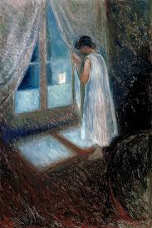
…gets up sooooo early.

Slide 52
…Carlos

Slide 53
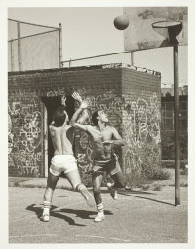
…loooves sport, especially basketball.

Slide 54
…Mauricio

Slide 55

…likes to read psychology books( even advised me one).

Slide 56
…Marilyn

Slide 57
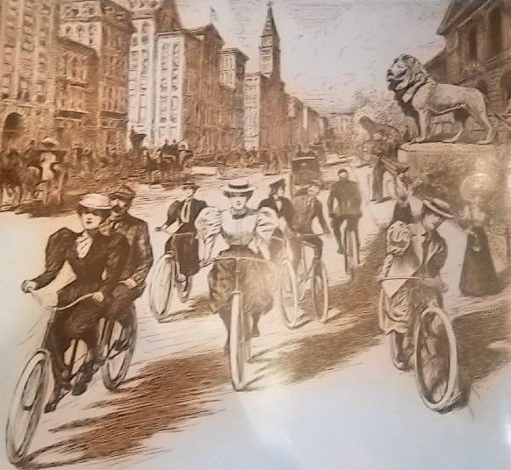
…is our avid biker

Slide 58
…Semaje!

Slide 59
Thank you!;)

